Slide 1
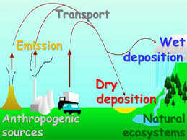
Atmospheric Deposition
LaToya Myles
Air Resources Laboratory
June 22, 2016

Slide 2
Relevance
Under the Clean Air Act Amendments of 1990, NOAA is charged to
Identify and assess the extent of deposition of atmospheric pollutants to Great Lakes and coastal waters and
Conduct research on air quality and deposition and associated impacts to ecosystems.
ARL’s Deposition R&D is grounded in the early days of acid rain studies and assessments with the National Acid Precipitation Assessment Program.

Slide 3
Key Scientific Question for Deposition
Current work continues to address atmospheric transport, transformation and fate of air pollutants
NOAA Five-Year R&D Plan:
“How are atmospheric chemistry and composition related to each other and ecosystems, climate, and weather?”

Slide 4
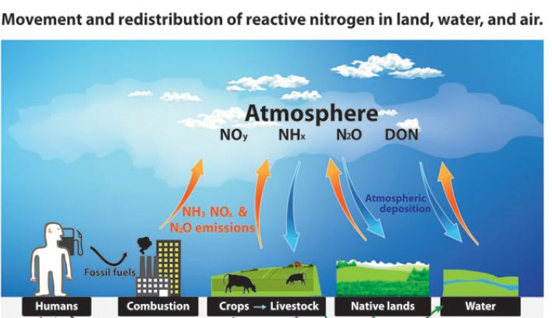
R&D Goal Advance scientific understanding of
air-surface exchange of air pollutants
that impact human and ecosystem health
Research Priorities
Precipitation Chemistry
Reactive Nitrogen Research
Atmospheric Integrated Research
Monitoring Network - AIRMoN

Slide 5
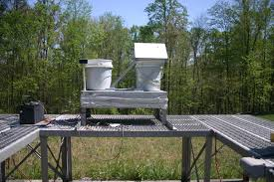
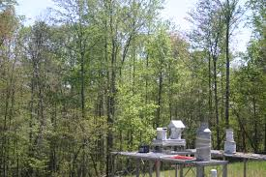
AIRMoN Approach
Joined National Atmospheric Deposition Program (NADP) in 1992
Operates six monitoring sites for wet deposition
Supports national networks that measure the most abundant trace chemicals in precipitation
Produces high-quality data that are publicly accessible and used in numerous assessments

Slide 6
AIRMoN Sites

Slide 7
AIRMoN Products and Performance
Sulfate Trends
Inorganic Nitrogen Trends

Slide 8
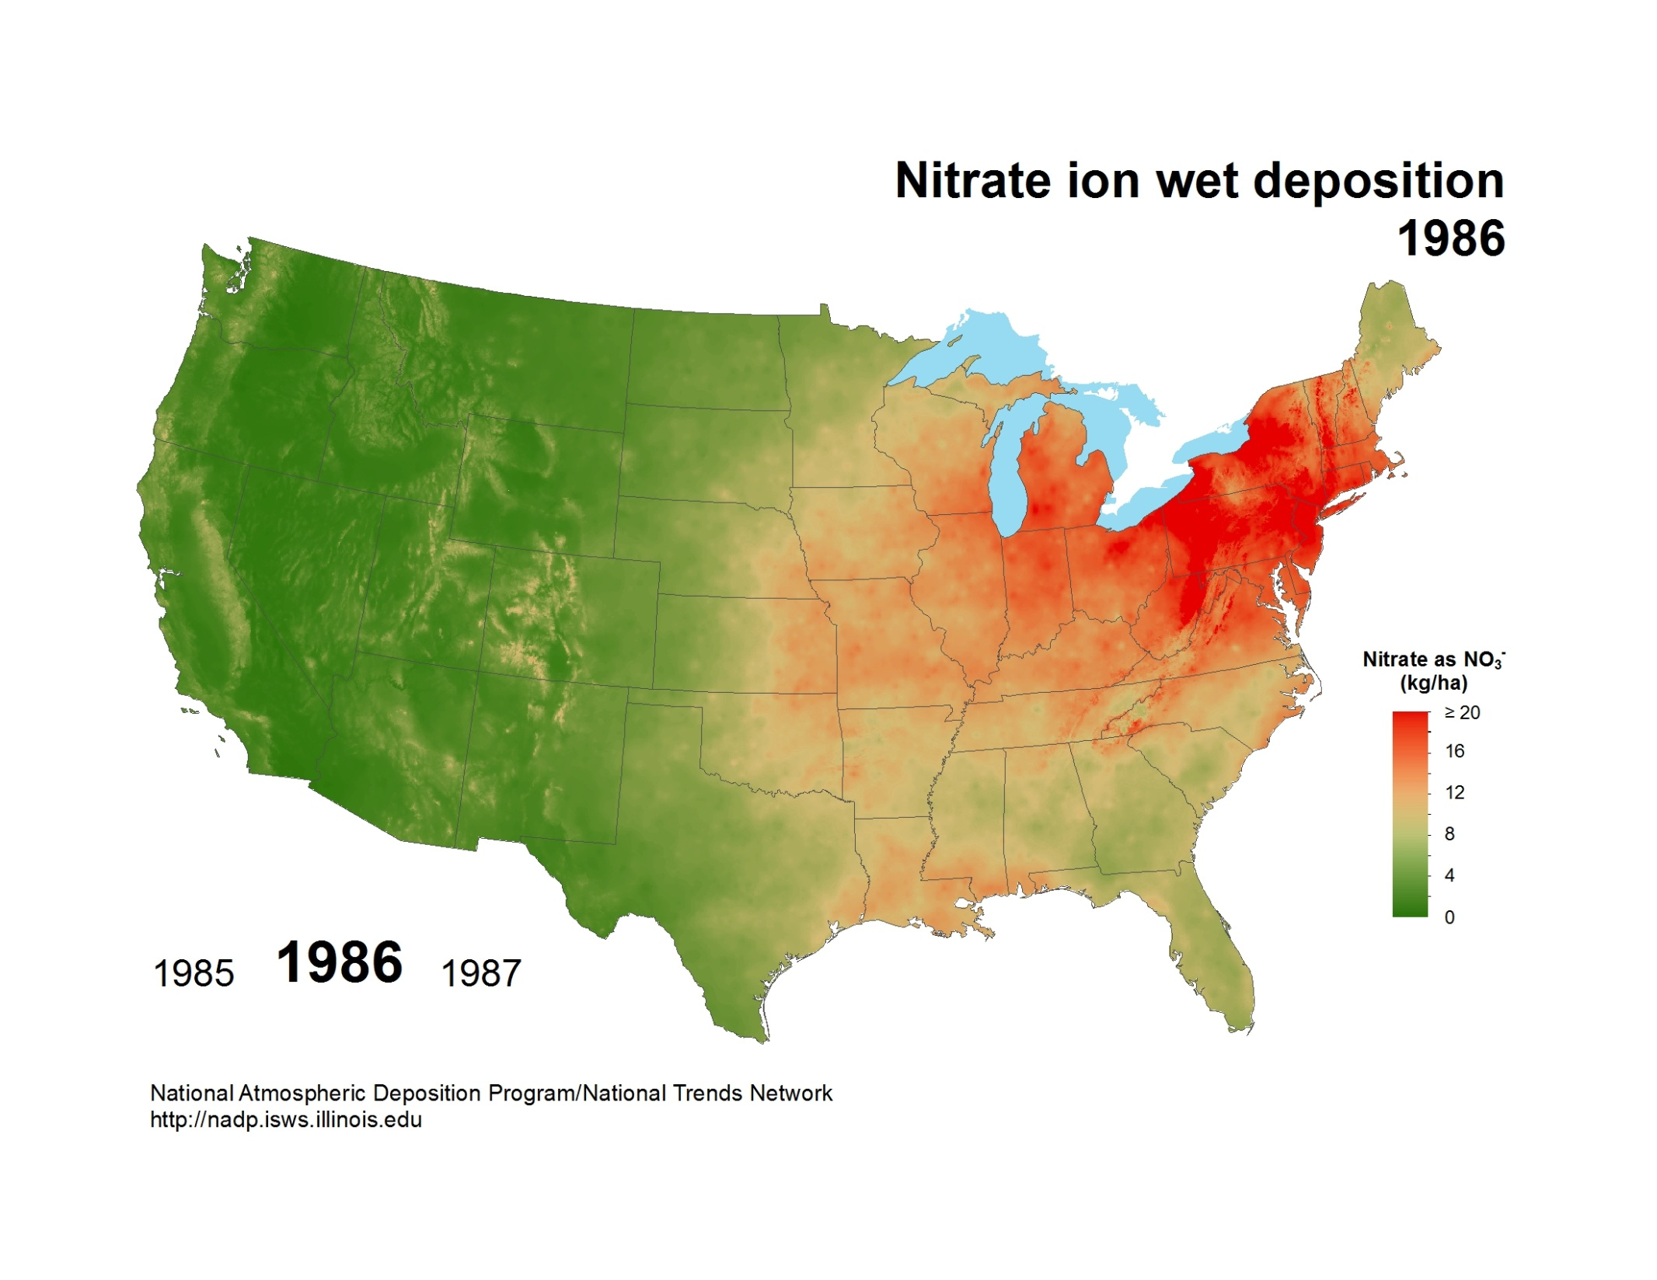

Slide 9
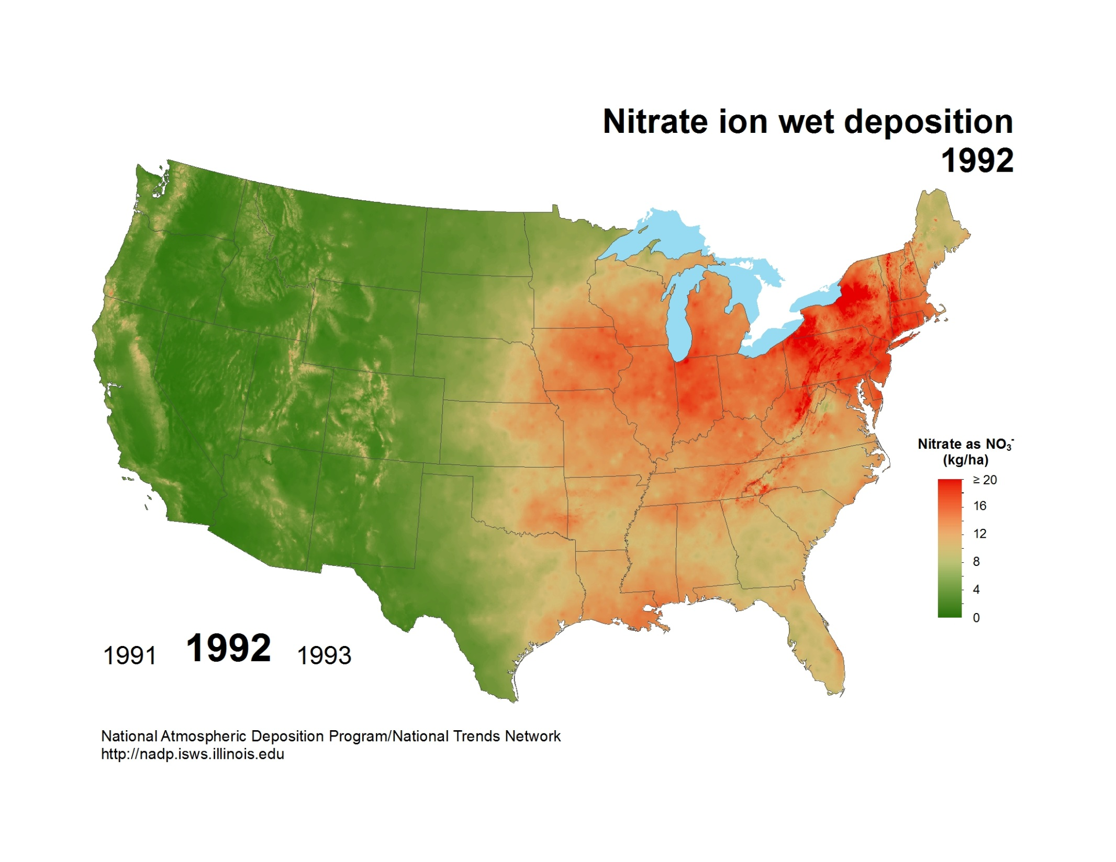

Slide 10
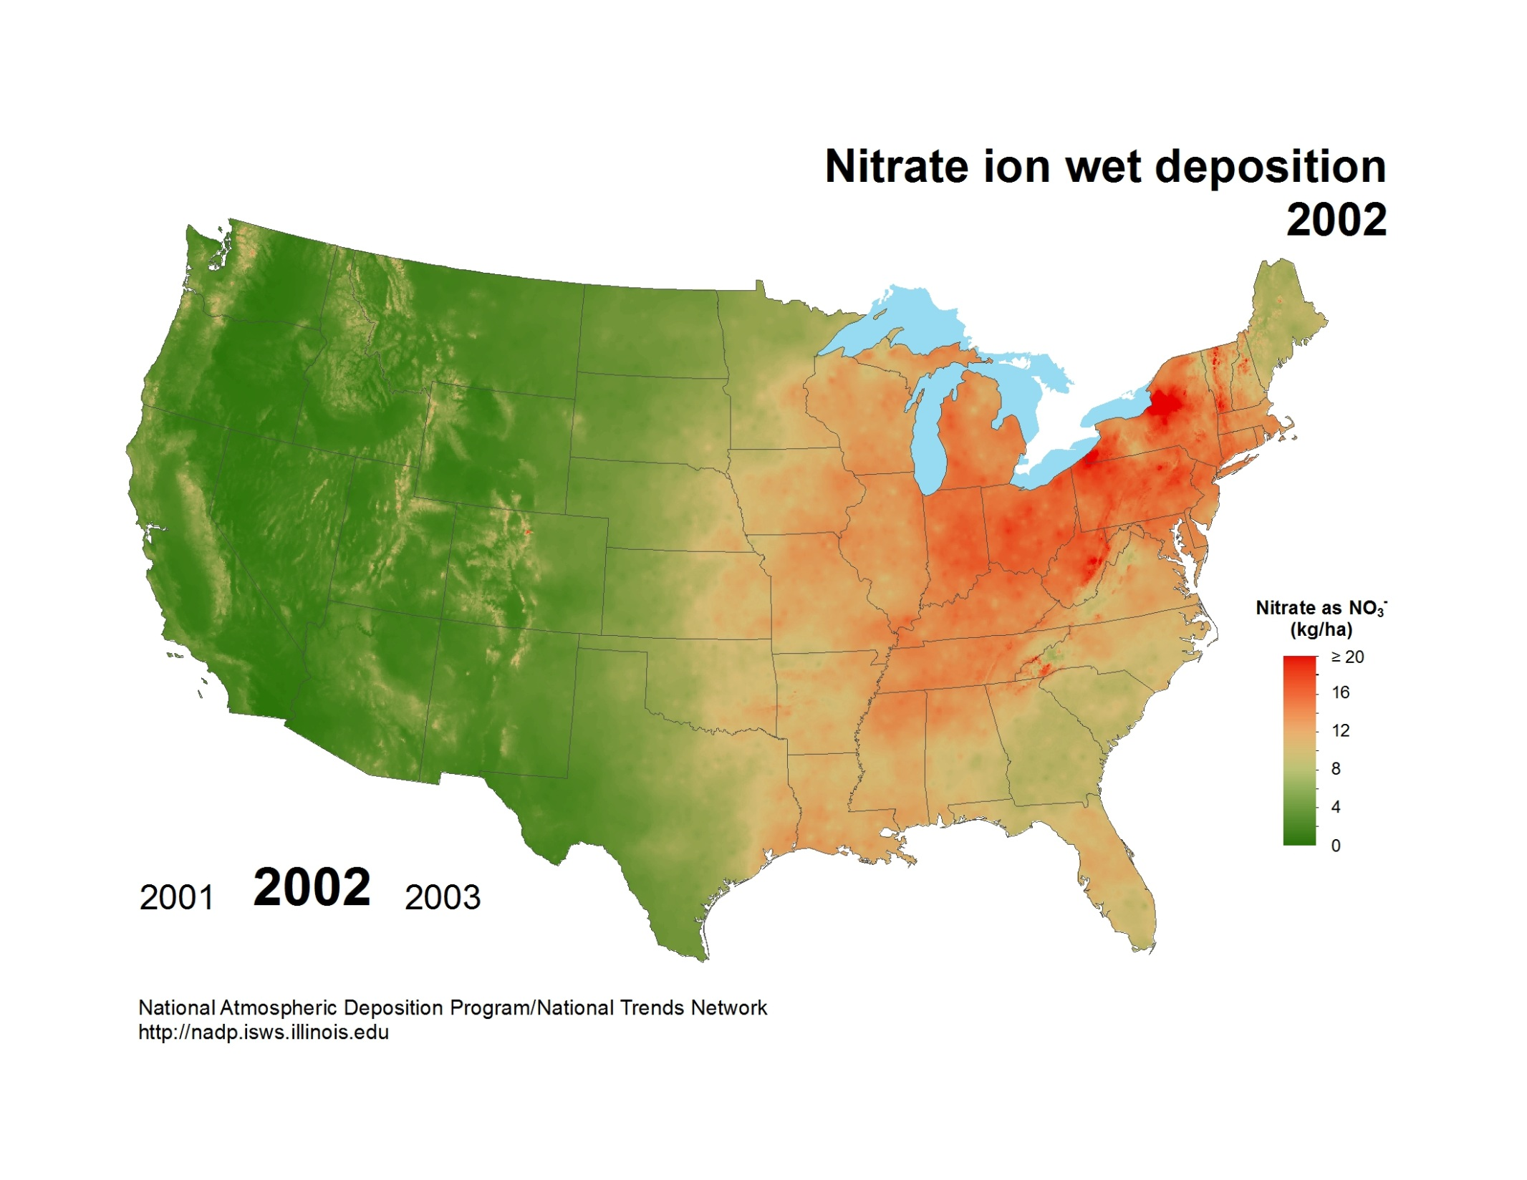

Slide 12
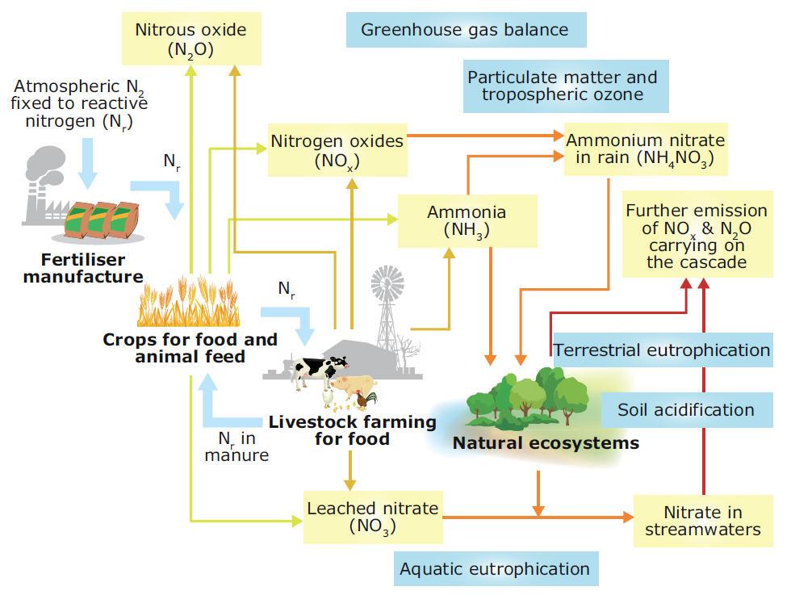
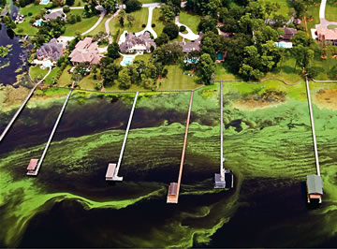
Reactive Nitrogen in the Environment

Slide 13
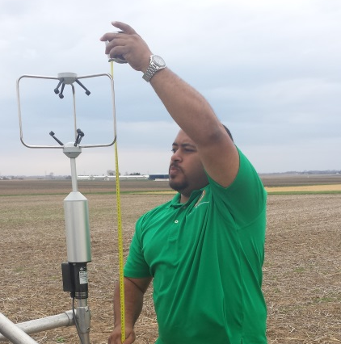
Reactive Nitrogen Approach
Process Studies
Field measurements to understand the processes that influence transfer of nitrogen gases and particles between the atmosphere and land
Support characterization of emission sources and other key factors that influence air quality in different regions

Slide 14
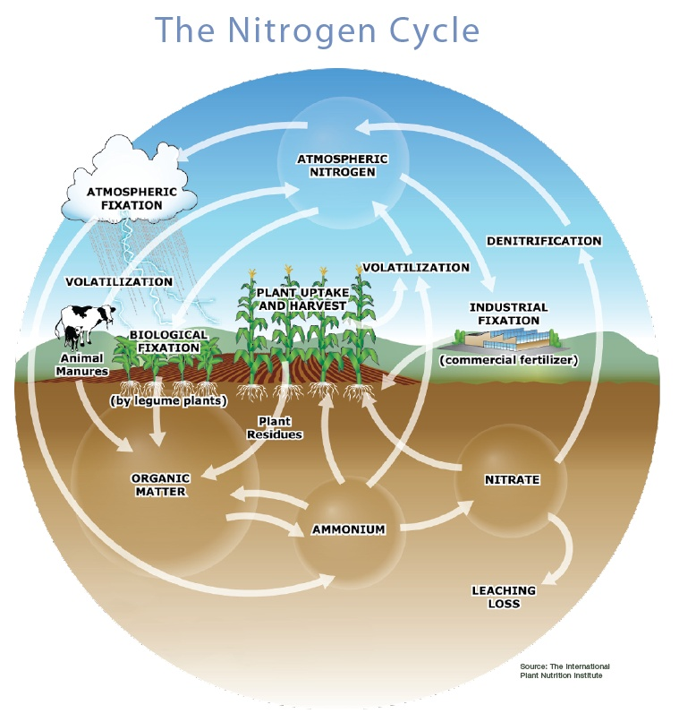
Reactive Nitrogen Collaborative Studies
NOAA-funded study of reactive nitrogen biogeochemical cycling in partnership with OAR GFDL
NSF-funded study of ammonia emission as an uncertain input to air quality models in partnership with the University of Illinois at Urbana-Champaign

Slide 15
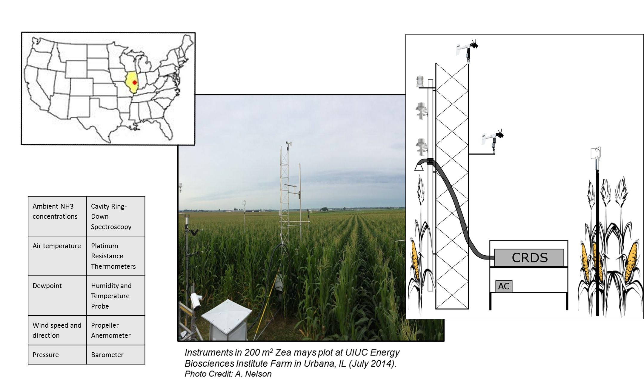
2014 Illinois NH₃ Study

Slide 16
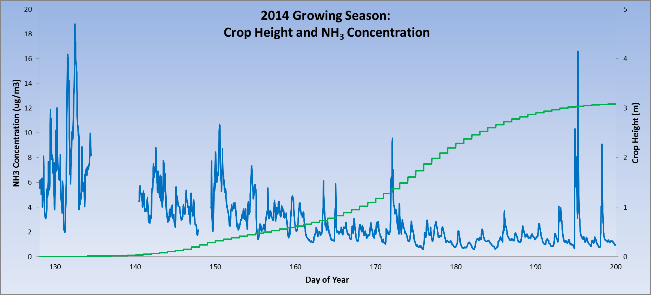
Reactive Nitrogen Products
Quality data and information that improves emission estimates and modeling capabilities on local and regional scales.
Notes:
The first graph is of the entire growing season, with NH3 concentration (ug/m3) on one axis and crop height on the other. Of note, the ambient NH3 conc falls over the course of the season to pretty miniscule amounts (.7 ug/m3 or about 1ppb). The big spikes in concentration are often driven by no wind (in case someone asks.)

Slide 17
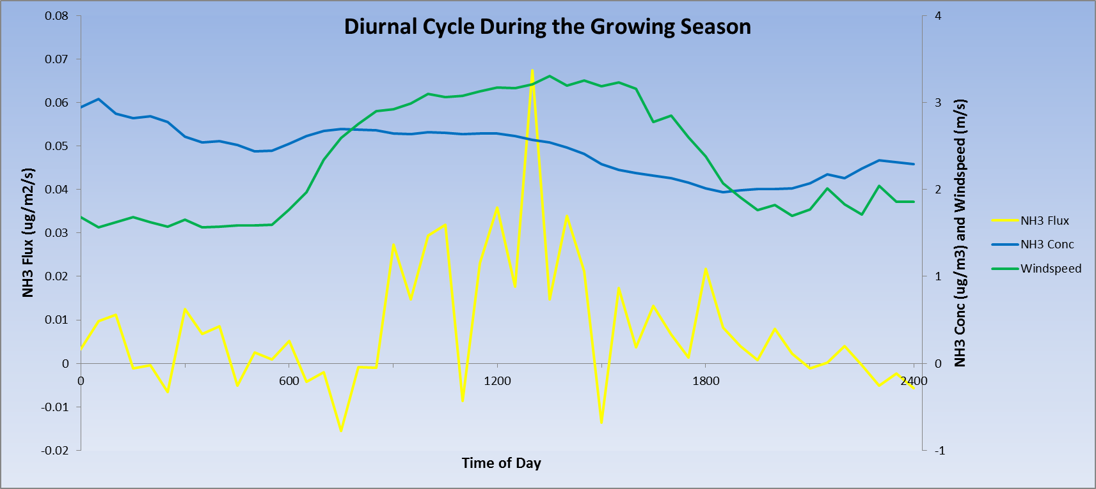
Reactive Nitrogen Products
Ammonia flux data that improves understanding of the
physical processes that influence emission and deposition.

Slide 18
Deposition Research Challenges
Maintaining high-quality precipitation measurements is time-consuming and costly.
Comprehensive reactive nitrogen field measurements (both reduced and oxidized forms, including organics) are logistically challenging and expensive.
Air-surface exchange of reactive nitrogen in complex ecosystems (coastal wetlands) is relatively unknown.

Slide 19
Collaborators
External Partners
Internal Partners

Slide 20
Future Directions
Precipitation Chemistry
Continue leadership of AIRMoN as part of NADP

Slide 21
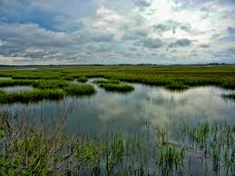
Future Directions
Reactive Nitrogen Research
To investigate reactive nitrogen emission and deposition from fires
To improve understanding of the role of nitrogen deposition in coastal blue carbon sequestration
Nitrogen
Carbon
Deposition
Fixation
Notes:
ARL & NCCOS
Goal: Improve understanding of the biological, chemical, and physical processes that drive the exchange of carbon dioxide and nutrients between the atmosphere, land, and water in coastal ecosystems.
NOS National Centers for Coastal Ocean Science
nitrogen limited, so increases in nitrogen can increase C fixation.

Slide 22
Atmospheric Deposition
Acknowledgments
R. Artz, M. Heuer: NOAA ARL
M. Rood, S. Koloutsou-Vakakis, A. Nelson: Univ of Illinois
J. Caldwell, D. Sibble: Florida A&M Univ

